Slide 1
ETRSS-1 AOCS In-orbit Operation Instructions
Beijing Institute of Control Engineering
Oct, 2019

Slide 2
Contents
Satellite-ground control loop
AOCS
AOCS Composition Units
Work Modes
Flight Procedures
Operations
Telemetry Introduction
Q&A

Slide 3
Satellite-ground control loop
Satellite
Other Subsystems
OBDH
AOCS
TT&C
Subsystem
Ground Station

Slide 4
AOCS
Mission of AOCS: Provide the attitude required by the work-mode of satellite
Solar zone: Sun Pointing Mode (Coarse)
Shadow zone: Earth Pointing Mode
Imaging: Attitude Maintaining Mode towards target (Mainly roll-maneuvering )
AOCS Composition
Controller
Central Control Unit (CCU)
Actuator
Momentum Wheel (MW) |  | Magnetic Torquer (MT)
Sensor
Fiber-optical gyro(FOG) | Dual axis micro-analog sun sensor(ASS) |  | Digital magnetometer (MM) | Nano Star Sensor (STS) | SOC digital sun sensor (DSS)

Slide 5
AOCS
CCU
Nano Star Sensor
RS422
RS422
Fiber-optical gyro
Dual axis micro-analog sun sensor
I/O
Digital magnetometer
RS485
External
systems
SOC digital sun sensor
RS422
Momentum Wheel
RS422
Magnetic Torquer
I/O

Slide 6
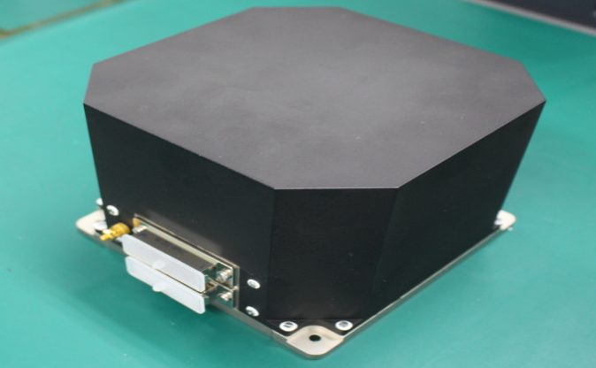
AOCS Composition Units
Fiber-Optical Gyroscope
Due to the limit on life, weight and power consumption, it is required to select the gyroscope with miniaturization, integration, and low power consumption.
Object | Index
Weight | ≤1.4kg
Power Consumption | Steady-state 8.2W Initialization 13W
Measurement range | -50˚/s~+50˚/s
Size | 157mm×130mm×106mm
Interface | 4×RS422
Power Supply | -12V、5V, independently for 4 gyro-heads

Slide 7
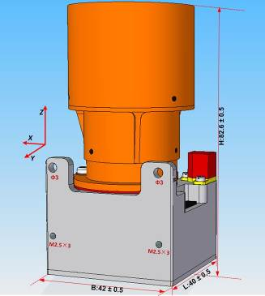
AOCS Composition Units
Nano Star Sensor
STS is the core sensor for attitude determination. Due to the limit on weight and power consumption, it is required to select the STS with miniaturization, integration, and low power consumption.
Object | Index
Measurement accuracy | Around the optic axis:≤10˝(3σ) Perpendicular to the optic axis:≤50˝(3σ)
Field of View | 21˚×18˚
Work Temperature | -20˚C~+40˚C
Size | 96mm×40mm×40mm
Interface | RS422+2 differential signals
Power Consumption | ≤1.5W
Weight | ≤200g

Slide 8
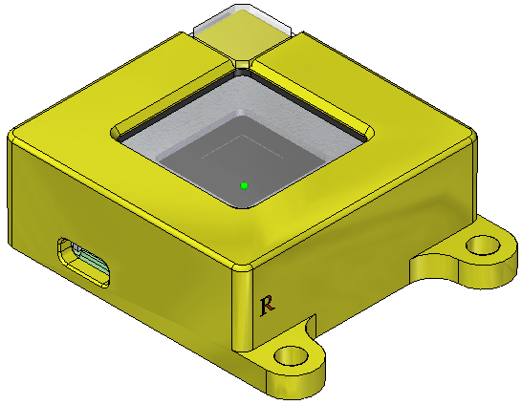
AOCS Composition Units
Dual axis micro-analog sun sensor
SS is mainly used in injection period and also used for the Sun acquisition under emergency situation. Successful in Obiter-1 and MO-1.
Object | Index
Field of View | ±64˚×±64˚
Measurement Accuracy | ≤0.5˚(3σ)
Weight | <30g
Work Temperature | -70˚C~+70˚C
Life | 5 years
Size | 34.5±1mm×48.5±1mm×13.5±1mm

Slide 9
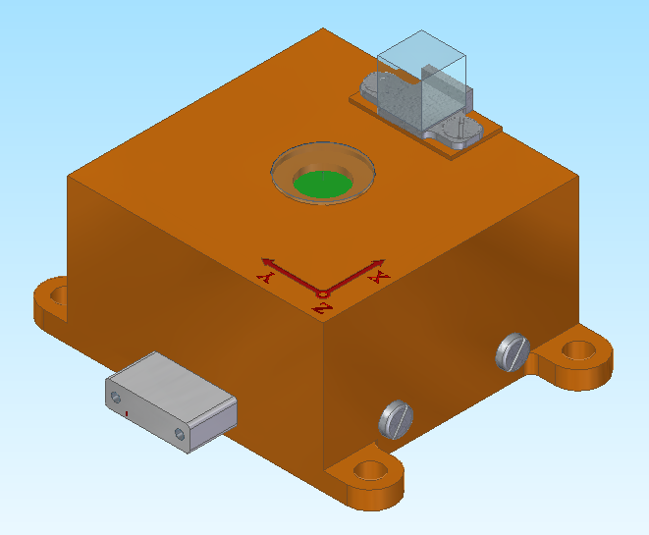
AOCS Composition Units
SOC Digital Sun Sensor
SOC (System no a Chip) Digital Sun Sensor is an experimental unit on board.
The unit uses APS image sensor and optical mask to make a sun sensor with the weight of no more than 40g and 0.03° in accuracy.
Object | Index
Field of View | ±64˚×±64˚
Measurement Accuracy | ≤0.03˚(3σ)
Data updating rate | ≥10 Hz
Weight | ＜40g
Power consumption | ＜0.5W

Slide 10
AOCS Composition Units
Digital Magnetometer
ETRSS-1 selects 2 HMR 2300 3-axis magnetometer, backup for each other. Successful in PN-1, OVS-1 and MO-1.
Object | Index | Object | Index
Field of View | ±64˚×±64˚ | Size | 83mm×25mm×22mm（body） 106.5mm×38mm×22.5mm （envelop）
Measurement Accuracy | 0.01%~0.52% | Measurement Range | ±1Gauss
Resolution | 0.000067Gauss | Average measurement error | 0.0013Gauss (1σ)
Power Supply | 6.5V~15V | Current | 27mA~45mA

Slide 11
AOCS Composition Units
Momentum Wheel
MWs are the main actuators for maneuvering. Besides, they are the core devices for implementing zero-momentum control strategy. ETRSS-1 selects FW-SR.090.0.1-1C type of MW.
Object | FW-SR.090.0.1-1C
Work speed | 6000rpm
Max moment output | ≥15m Nm
Angular momentum | 0.36Nms(tentatively)
Steady-state power consumption | ≤1W（0.06Nms,1000rpm） ≤3W（0.18Nms,3000rpm） ≤9W（0.36Nms,6000rpm） (tentatively)
Weight | ≤1kg
Life | 5 years

Slide 12
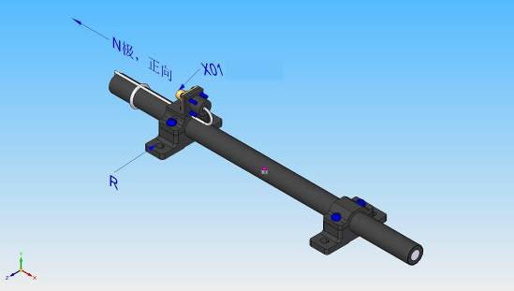
AOCS Composition Units
Magnetic Torquer
MT is mainly used for unloading angular momentum and magnetic damping. The MT selected in ETRSS-1 is 1Am² of MT that has been applied on OVS-1 and MO-1.
Object | Index
Max-output | 1Am²±5%
Remnant magnetic moment | ＜0.01Am²
Control signal | 5V pulse
Power consumption | ≤1.35W
Weight | <200g
Work Temperature | -15˚C~+45˚C
Life | 5 years
Size | 115mm×Φ14mm

Slide 13
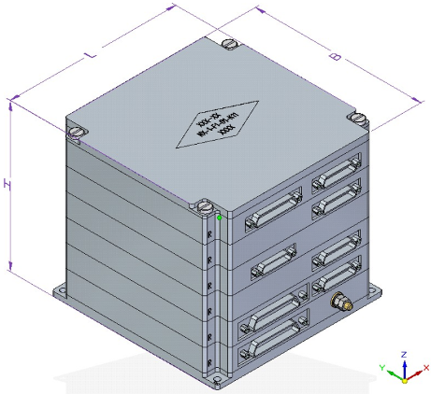
AOCS Composition Units
Central Control Unit
CCU utilized in ETRSS-1 is the type of double units with cold redundant computer. CCU is the controller of attitude control subsystem in ETRSS-1, which is consist of AOCC and FT. AOCC, applied with the double circuit design, is utilized for dealing with the measurements from other units and activating the actuators, except for propulsion system. Most of components in the CCU are military grade, and the rest is industrial grade.
Word length | 32bits
CPU frequency | 45MHz
Memorizer | 4MB Flash 2MB SRAM
Control cycle | 250ms±0.1ms
Timer | 32bits counter, accuracy≤20μs

Slide 14
Work Modes
Attitude control subsystem of ETRSS-1 has 6 work modes:
No. | Work Mode | Sensors | Actuators | Application Scenarios
2 | Global Attitude Acquisition Mode (AAM) | FOG,SS,MM,STS | MW,MT | Unusual attitude occurs、After the separation
3 | Sun Pointing Mode (SPM) | FOG,SS,MM,STS | MW,MT | Sun-orientated operation
4 | Maneuver Mode (MAM) | FOG,MM, STS | MW,MT | Between the imaging mission and no imaging mission
5 | Earth Pointing Mode (EPM) | FOG,SS,MM,STS | MW,MT | Earth-orientated operation
6 | Attitude Maintaining Mode(AMM) | FOG,SS,MM,STS | MW,MT | After roll maneuver and yaw 90˚ calibration
12 | Stop Control Mode(SCM) | FOG,SS,MM,STS | None | Operation failure

Slide 15
Work Modes
Switch between work modes:
SCM
Workmode=12
Initialization
AAM
Workmode=2
SEPARATION
AMM
Workmode=6
SPM
Workmode=3
EPM
Workmode=5
MAM
Workmode=4

Slide 16
Work Modes
Global Attitude Acquisition Mode
After the separation or satellite operates with an unusual attitude, satellite will work into global attitude acquisition mode, which includes 5 sub-modes.
Sub-mode | Function
Angular rate damping | Decrease the angular velocity of satellite to a required range by MW damping or magnetic damping.
Sun acquiring | After completing the angular rate damping, the satellite is controlled by MW for capturing the sun.
Sun orientation | The –Z axis of satellite is controlled to implement the Sun- orientation by utilizing the measurements from SS.
Attitude Adjustment in Sun-pointing | Intermediate state for the satellite turns to SPM by remote instructions from the ground.
Attitude Adjustment in Earth-pointing | Intermediate state for the satellite turns to EPM by remote instructions from the ground.

Slide 17
Work Modes
Coarse Sun Pointing Mode
SPM is the normal operation mode for the satellite. The attitude determination scheme of the mode is “FOG with STS” or “FOG with MM” . Attitude of the satellite is controlled by MW. And the redundant angular momentum is unloaded by the MT.
Maneuver Mode
An interim mode. Utilize estimation of FOG to implement attitude determination and MW to complete attitude maneuver.
Earth Pointing Mode
The satellite works in the three-axis zero-attitude earth-orientation operation, The attitude determination scheme of the mode is “FOG with STS” or “FOG with MM” . Attitude of the satellite is controlled by MW. And the redundant angular momentum is unloaded by the MT.

Slide 18
Work Modes
Attitude Maintaining Mode
AMM follows by MAM to keep the required attitude, roll angle for imaging or yaw 90° for calibration. “FOG with STS” or “FOG with MM” is used for attitude determination. Attitude control is implemented by MW. And the redundant angular momentum is unloaded by the MT.
Stop Control Mode
The satellite can transfer into SCM autonomously or by remote control. In this mode, the CCU will not work on attitude control any more. Only the measurement and orbit calculation are conducted. Output of actuators is ZERO.

Slide 19
Flight Procedures
The whole satellite is powered-off before launching.
0s | Separation
3s | Send AOCC A power-on
5s | Resend AOCC A power-on
11s | Send FT power-on
33s | Operating in AAM - Angular rate damping sub-mode autonomously
 | Send Power-on command for several units of AOCS in sequence autonomously : MM A, MM B, Main optical source of FOG, Gyro X of FOG, Gyro Y of FOG, Gyro Z of FOG, Gyro S of FOG, MW X, MW Y, MW Z, MW S, MT X, MT Y, MT Z, STS A, STS B. 0.25s per command (4s in total)
40s | Resend command: Operating in AAM

Slide 20
Flight Procedures
41s | Resend command: MM A Power-on
42s | Resend command: MM B Power-on
43s | Resend command: Main optical source of FOG Power-on
44s | Resend command: FOG X Power-on
45s | Resend command: FOG Y Power-on
46s | Resend command: FOG Z Power-on
47s | Resend command: FOG S Power-on
48s | Resend command: MT X Power-on
49s | Resend command: MT Y Power-on
50s | Resend command: MT Z Power-on
51s | Resend command: MW X Power-on
52s | Resend command: MW Y Power-on
53s | Resend command: MW Z Power-on

Slide 21
Flight Procedures
54s | Resend command: MW S Power-on
55s | Resend command: STS A Power-on
56s | Resend command: STS B Power-on
 | Turning into Sun acquiring and sun Orientation sub-mode of AAM autonomously after completing angular rate damping
 | Inject orbit parameters
 | Send command: Use GPS time correction
 | Send command: Turning to coarse SPM from sun-pointing attitude adjustment sub-mode of AAM
 | Send command: Attitude determination uses STS with FOG.

Slide 22
Operations
AOCS cooperates with the other subsystems to complete the imaging mission. Several command sequences will be applied for AOCS to implement the cooperation by providing a satisfied attitude condition.
No. | Function of the command sequence
1 | Mode transfer to EPM (Used for data transmission)
2 | Mode transfer to AMM (Used for imaging mission)

Slide 23
Operations
Command sequence 1
Step | Command | Telemetry | Description | Definition and result
1 | Send: Switch autonomously between EPM and SPM | TMK278-3 | Autonomously switch FLAG between EPM and SPM | D3=0:Not allowed; D3=1: Allowed;
2 | Send: Operate EPM | TMK103 | Control Mode Word | 40H: MAM; 50H: EPM;
3 | Inject: Maneuver Data Block | TMK171 | Count of successful injections | +1
4 | Send: Off-set Flight | TMK103 | Control Mode Word | 40H: MAM; 60H:AMM;
 |  | TMK104 | Angle of roll | As the same as the set
 |  | TMK105 | Angle of pitch | As the same as the set
5 | Send: Off-set Flight Return | TMK103 | Control Mode Word | 40H: MAM; 50H:EPM;
6 | Send: Switch autonomously between EPM and SPM | TMK278-3 | Autonomously switch FLAG between EPM and SPM | D3=0:Not allowed; D3=1: Allowed;
 |  | TMK280-5 | FLAG of solar zone | 1: Solar zone; 0: Shadow zone;

Slide 24
Operations
Command sequence 2
Step | Command | Telemetry | Description | Definition and result
1 | Send: Switch autonomously between EPM and SPM | TMK278-3 | Autonomously switch FLAG between EPM and SPM | D3=0:Not allowed; D3=1: Allowed;
2 | Inject: Maneuver Data Block | TMK171 | Count of successful injections | +1
3 | Send: Off-set Flight | TMK103 | Control Mode Word | 40H: MAM; 60H:AMM;
 |  | TMK104 | Angle of roll | As the same as the set
 |  | TMK105 | Angle of pitch | As the same as the set
4 | Send: Off-set Flight Return | TMK103 | Control Mode Word | 40H: MAM; 50H:EPM;
5 | Send: Switch autonomously between EPM and SPM | TMK278-3 | Autonomously switch FLAG between EPM and SPM | D3=0:Not allowed; D3=1: Allowed;
 |  | TMK280-5 | FLAG of Solar Zone | 1: Solar zone; 0: Shadow zone;

Slide 25
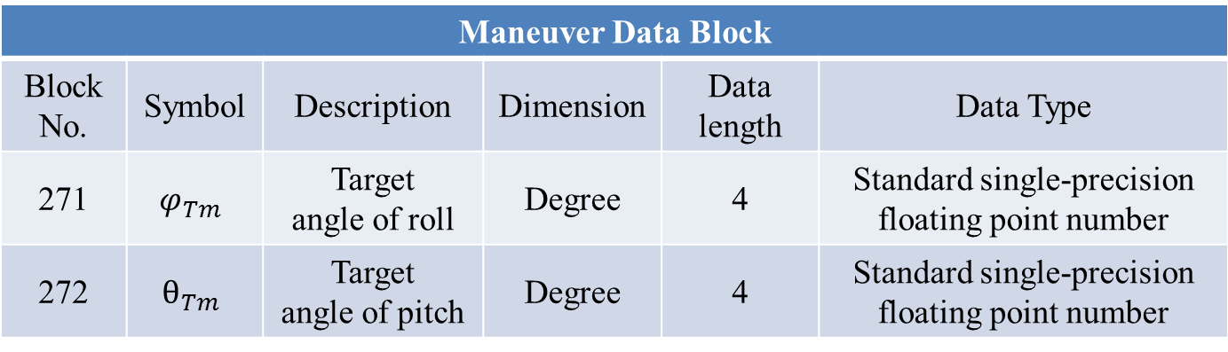
Operations
Fixed Address Parameter of Maneuver Data Block
Maneuver Data Block
Block No. | Symbol | Description | Dimension | Data length | Data Type
271 | $$φ_{Tm}$$ | Target angle of roll | Degree | 4 | Standard single-precision floating point number
272 | $$θ_{Tm}$$ | Target angle of pitch | Degree | 4 | Standard single-precision floating point number

Slide 26
Telemetry Introduction
There are 2 types of telemetry (TM) sent to OBDH by AOCS
NO. | Type | Period | Length | Description
1 | AOCS FAST TM (24H) | 1sec/frame | 128 bytes | AOCS FAST TM1 and AOCS FAST TM2 download alternately, the period for each is 2 sec/frame. AOCS FAST TM2 can be replaced by “Returning TM of injected orbit parameter” for 3 AOCS FAST TM2 periods once the satellite receives the orbit parameter injection.
2 | AOCS SLOW TM (44H) | 32sec/frame | 128 bytes | AOCS SLOW TM1 and AOCS SLOW TM2 download alternately, the period for each is 64 sec/frame.

Slide 27
Telemetry Introduction
Telemetry Code | Name | Interpretation criterion
TMK102 | Satellite Time | The satellite time starts to increase since the AOCS is powered on. The satellite time can be corrected by applying GPS Time Correction.
TMK103 | Control Mode Word | 21H:AAM-angular rate dumping; 22H:AAM-sun acquiring; 23H:AAM-sun orientation; 24H:AAM- attitude adjustment in earth-pointing; 25H:AAM- attitude adjustment in sun-pointing; 30H:SPM; 40H:MAM; 50H:EPM; 60H:AMM; C0H:SCM.
TMK104 | Angle of roll | Current attitude angle of satellite
TMK105 | Angle of pitch
TMK106 | Angle of yaw

Slide 28
Telemetry Introduction
Telemetry Code | Name | Interpretation criterion
TMK107 | Angular rate of roll | Current attitude angular rate of satellite
TMK108 | Angular rate of pitch
TMK109 | Angular rate of yaw
TMK116 | Angular rate of FOG X | Measured angular rate by FOG In maneuvering: -0.6˚/s~ +0.6˚/s; Others:-0.1˚/s~ +0.1˚/s;
TMK117 | Angular rate of FOG Y
TMK118 | Angular rate of FOG Z
TMK119 | Angular rate of FOG S
TMK120 | ASS α | Solar zone: Sun; Absolute value ＜ 5˚; Shadow zone: No Sun.
TMK121 | ASS β
TMK138 | STS A status information | When STS is available: D7(effectiveness of attitude data)=1:normal attitude information; D2~D0:current work mode of STS: Mode C.
TMK147 | STS B status information

Slide 29
Telemetry Introduction
Telemetry Code | Name | Interpretation criterion
TMK152 | Rotation rate of MW X | Steady operation in SPM and EPM: 1667±200 rpm
TMK153 | Rotation rate of MW Y
TMK154 | Rotation rate of MW Z
TMK155 | Rotation rate of MW S | 2887±50 rpm
TMK160 | Pulse width of MT X | Effective output varies between: -250ms~+250ms
TMK161 | Pulse width of MT Y
TMK162 | Pulse width of MT Z
TMK167 | Units Power Status 1 | D7(STS A)=1: Power on; D6(STS B)=1: Power on; D5(FOG X)=1: Power on; D4(FOG Y)=1: Power on; D3(FOG Z)=1: Power on; D2(FOG S)=1: Power on; D1(MM A)=1: Power on; D0(MM B)=1: Power on.

Slide 30
Telemetry Introduction
Telemetry Code | Name | Interpretation criterion
TMK168 | Units Power Status 2 | D7(MW X)=1: Power on; D6(MW Y)=1: Power on; D5(MW Z)=1: Power on; D4(MW S)=1: Power on; D3(MT X)=1: Power on; D2(MT Y)=1: Power on; D1(MT Z)=1: Power on; D0(DSS)=1: Power on.
TMK170 | System Software TM word 2 | D12~D10(Count of accumulated reset) : 0; D5(Flag of CCU) : CCU A; D4(Flag of CCU A power state):1: Power on; D3(Flag of CCU B power state):0: Power off; D2(Flag of FT power state)=1: Power on; D1(Status of FOG Main Power resource): 1: Power on; D0(Status of FOG Backup Power resource) 0: Power off.

Slide 31
Telemetry Introduction
Telemetry Code | Name | Interpretation criterion
TMK171 | Count of successful injections | +1 after injecting data block
TMK268 | State of Health and Use of FOG | D7(Health state of FOG S)=1: Healthy; D6(Health state of FOG Z)=1: Healthy; D5(Health state of FOG Y)=1: Healthy; D4(Health state of FOG Z)=1: Healthy; D3(Use state of FOG S)=1: Used; D2(Use state of FOG Z)=1: Used; D1(Use state of FOG Y)=1: Used; D0(Use state of FOG X)=1: Used.
TMK269 | Status of Sun Sensor | D7~D6(Health state of sun sensor): 1:Only ASS is healthy
TMK270 | Status of STS | D5~D4(Work status of STS): 0: Double STS work

Slide 32
Telemetry Introduction
Telemetry Code | Name | Interpretation criterion
TMK271 | State of Health and Use of MW | D7(Use state of MW S)=1: Used; D6(Use state of MW Z)=1: Used; D5(Use state of MW Y)=1: Used; D4(Use state of MW Z)=1: Used; D3(Health state of MW S)=1: Healthy; D2(Health state of MW Z)=1: Healthy; D1(Health state of MW Y)=1: Healthy; D0(Health state of MW X)=1: Healthy.
TMK272 | Flag of Time Correction | D6~D4 110B:GPS Time Correction
TMK278-5 | Flag of MM | D5 0: MM A;1 MM B
TMK278-3 | Autonomously switch FLAG between EPM and SPM | D3=0:Not allow; D3=1: Allow;
TMK279 | Fault flag of MM | D3(MM A)=1: Normal; D0(MM B)=1: Normal.

Slide 33
Telemetry Introduction
Telemetry Code | Name | Interpretation criterion
TMK280-5 | Flag of Solar zone | D5: 1: Solar zone; 0: Shadow zone.
TMK280-1 | Attitude Determination | D1~D0: 1:STS+FOG
TMK284 | Light source status of FOG | D7(Is there input for FOG X)=0: Yes; D6(Is there input for FOG Y)=0: Yes; D5(Is there input for FOG Z)=0: Yes; D4(Is there input for FOG S)=0: Yes;
TMK622 | 1.2V Power TM of CCU | 1.2±0.1V
TMK623 | 1.5V Power TM of CCU | 1.5±0.1V
TMK624 | 12V Power TM of CCU | 3.0±0.1V
TMK625 | -12V Power TM of CCU | -3.0±0.1V
TMK626 | 3.3V Power TM of CCU | 3.3±0.1V
TMK627 | Motor current of MW X | 20000~40000uA
TMK635 | Motor current of MW Y | 20000~40000uA
TMK643 | Motor current of MW Z | 20000~40000uA
TMK651 | Motor current of MW S | 45000~52000uA

Slide 34
Thank you for Listening!
Q&A?

